Slide 1
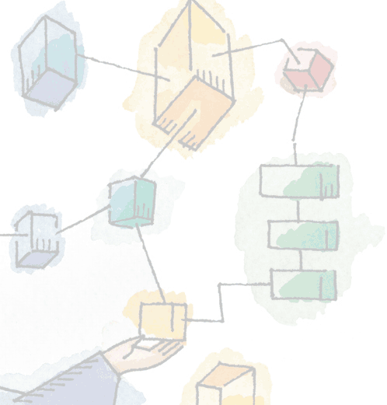
Chapter 2
Operating System Overview
Operating Systems:
Internals and Design Principles,
William Stallings

Slide 2
Operating System
A program that controls the execution of application programs
An interface between applications and hardware

Slide 3
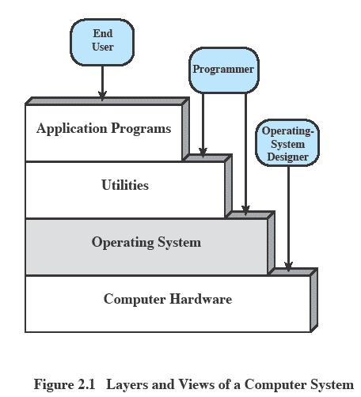
Layers and Views

Slide 4
Services Provided by the OS
Program execution
Access I/O devices
Controlled access to files
System access

Slide 5
Services Provided by the OS
Error detection and response
  Internal and external hardware errors
  Software errors
  Operating system cannot grant request of application

Slide 6
Services Provided by the OS
Accounting
  Collect usage statistics
  Monitor performance
  Used to anticipate future enhancements
  Used for billing purposes

Slide 7
Operating System
Responsible for managing resources
Functions same way as ordinary computer software
  It is a program that is executed
Operating system relinquishes control of the processor

Slide 8
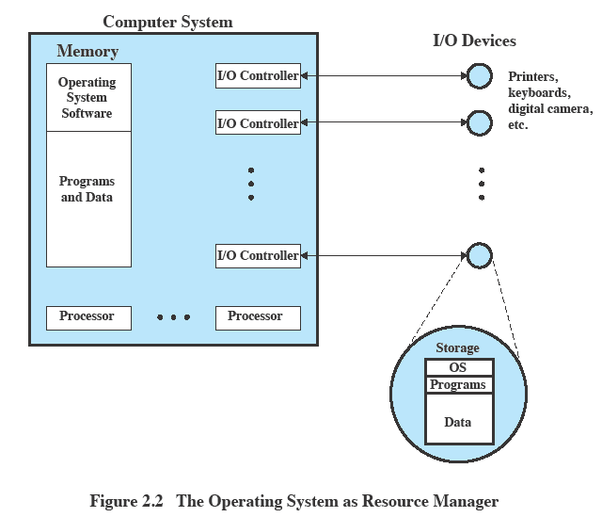
OS as Resource Manager

Slide 9
Kernel
Portion of operating system that is in main memory
Contains most frequently used functions

Slide 10
Evolution of Operating Systems
Hardware upgrades plus new types of hardware
  Device drivers
New services
  These days: rare.
Fixes
  Mostly: security fixes!

Slide 11
Evolution of operating systems
… a bit of history…

Slide 12
Evolution of Operating Systems
Serial processing
  No operating system
  Machines run from a console with display lights, toggle switches, input device, and printer

Slide 13
Evolution of Operating Systems
Serial processing
  Schedule time
  Setup included loading the compiler, source program, saving compiled program, and loading and linking

Slide 14
Evolution of Operating Systems
Simple batch system
  Monitor
    Software that controls the sequence of events
    Batch jobs together – job control language
    Program returns control to monitor when finished
  Hardware support for the monitor model
    Memory protection: some memory areas are accessible only to the monitor
    Privileged mode instructions: only accessible to the monitor
    Interrupts (early machines did not have this)

Slide 15

Uniprogramming
Processor must wait for I/O instruction to complete before proceeding

Slide 16
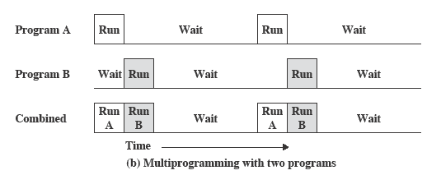
Multiprogramming
When one job needs to wait for I/O, the processor can switch to the other job

Slide 17
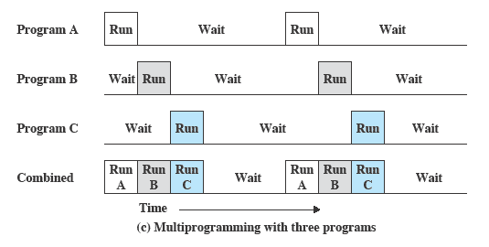
Multiprogramming

Slide 18
Time Sharing Systems
Using multiprogramming to handle multiple interactive jobs
Processor’s time is shared among multiple users
Multiple users simultaneously access the system through terminals

Slide 19
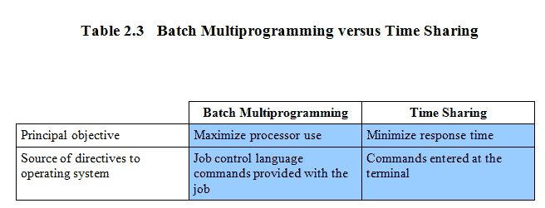
Batch Multiprogramming versus Time Sharing

Slide 20
Major achievements of operating systems

Slide 21
Major Achievements
Processes
Memory management
Information protection and security
Scheduling and resource management
System structure

Slide 22
Process
A program in execution
An instance of a program running on a computer
The entity that can be assigned to and executed on a processor

Slide 23
Process
A unit of activity characterized by
  A single sequential thread of execution
  A current state
  An associated set of system resources

Slide 24
Difficulties with Designing System Software
Improper synchronization
Failed mutual exclusion
Nondeterminate program operation
Deadlocks

Slide 25
Process
Consists of three components
  An executable program
  Associated data needed by the program
  Execution context of the program
    All information the operating system needs to manage the process

Slide 26
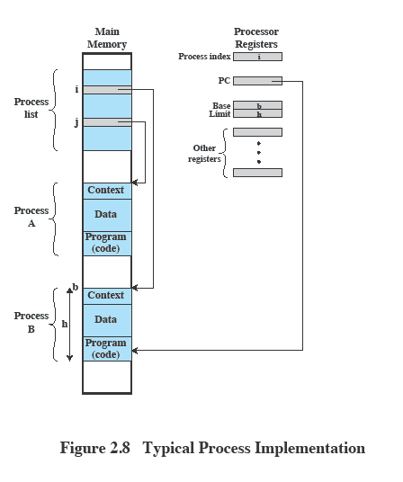
Process

Slide 27
Memory Management
Process isolation
Automatic allocation and management
Protection and access control

Slide 28
Virtual Memory
Allows programmers to address memory from a logical point of view
  Another layer of indirection
Allow the illusion of operating with a larger memory space than what is available in reality
  By storing some of the information on the file system

Slide 29
Paging
One way to implement virtual memory
Allows the process to be comprised of a number of fixed-size blocks, called pages
Virtual address is a page number and an offset within the page
Each page may be located anywhere in main memory
Real address or physical address is the main memory address

Slide 30
Information Protection and Security
Availability
  Concerned with protecting the system against interruption
Confidentiality
  Assuring that users cannot read data for which access is unauthorized

Slide 31
Information Protection and Security
Data integrity
  Protection of data from unauthorized modification
Authentication
  Concerned with the proper verification of the identity of users and the validity of messages or data

Slide 32
Scheduling and Resource Management
Fairness
  Give equal and fair access to resources
Differential responsiveness
  Discriminate among different classes of jobs

Slide 33
Scheduling and Resource Management
Efficiency
  Maximize throughput, minimize response time, and accommodate as many uses as possible

Slide 34
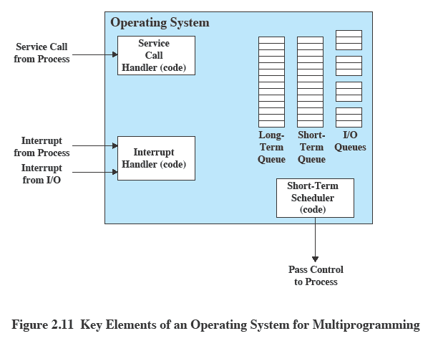
Key Elements of an Operating System

Slide 35
Modern Operating Systems
Microkernel architecture
  Assigns only a few essential functions to the kernel
    Address spaces
    Interprocess communication (IPC)
    Basic scheduling
  Was a hot topic in the 1990s
  Working examples Mach, QNX
  Current operating systems: Windows, Linux, Mac OS are not microkernel based

Slide 36
“designing a monolithic kernel in 1991 is a fundamental error. Be thankful you are not my student. You would not get a high grade for such a design :-) “
Andrew Tanembaum to Linus Torvalds

Slide 37
Modern Operating Systems
Multithreading
  Process is divided into threads that can run concurrently
    Thread
      Dispatchable unit of work
      Executes sequentially and is interruptable
    Process is a collection of one or more threads

Slide 38
Modern Operating Systems
Symmetric multiprocessing (SMP)
  There are multiple processors
  These processors share same main memory and I/O facilities
  All processors can perform the same functions

Slide 39
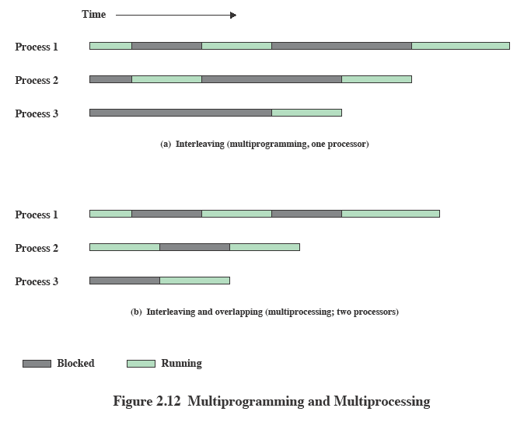
Multiprogramming and Multiprocessing

Slide 40
Modern Operating Systems
Distributed operating systems
  Provides the illusion of a single main memory space and single secondary memory space
  Eg. Amoeba by Andrew Tannembaum

Slide 41
Modern Operating Systems
Object-oriented design
  Used for adding modular extensions to a small kernel
  Enables programmers to customize an operating system without disrupting system integrity
Examples
  NeXTSTEP – Objective C, on top of BSD and the Mach kernel
  BeOS – C++ wrappers on top of a C kernel

